Slide 1
DXC REALTIME PROJECTS
Presented by:
Name : Konakalla Akhila

Slide 2
Project-1
Connecting Vehicles:
Vehicle has a third party IOT device which will send the telementry data over the AWS cloud.
You need to move data from third party AWS to general motor cloud.
You need to validate the JSON sometimes it will be incomplete or wrong JSON which need to be rejected.
Once JSON got validated this data would be stored in SQL database which will further utilized by data science team.

Slide 3
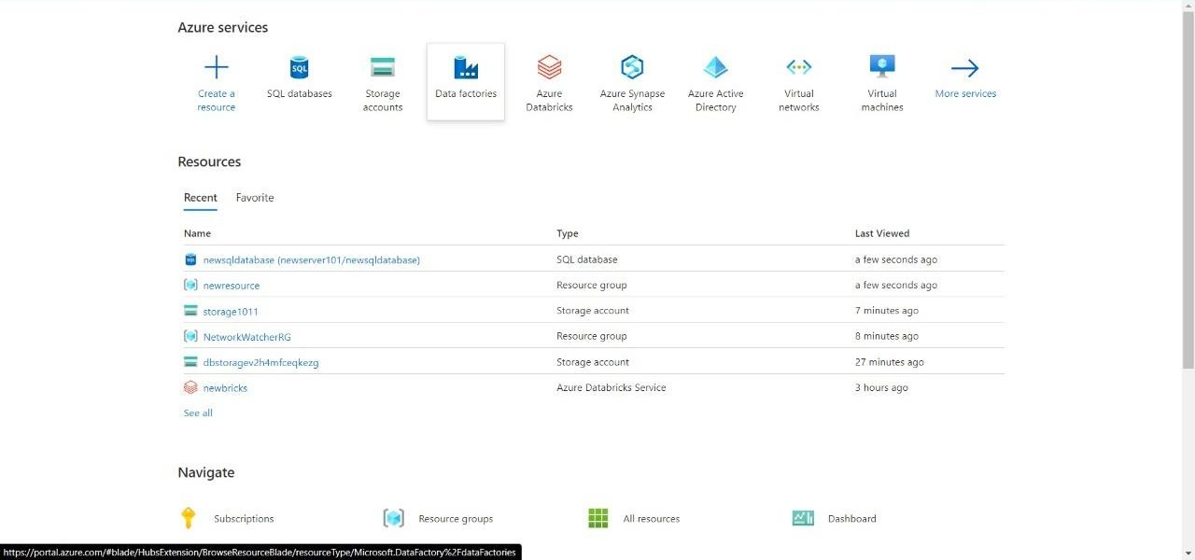
STEP-1 Open the microsoft azure and search for azure data factory:

Slide 4
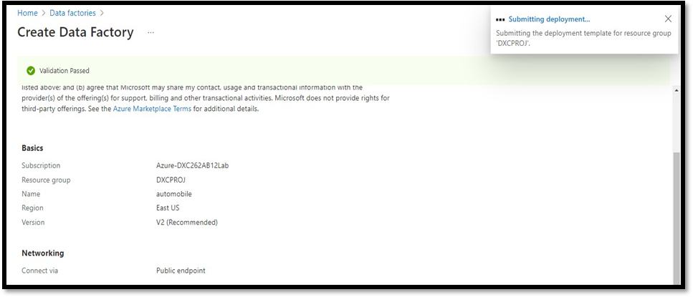
Step-2: After entering the details move towards validating the fields and Click on Create when successfully validated

Slide 5
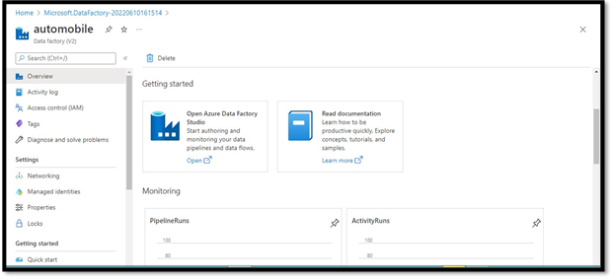
Step -3 After deployment is finished, click on go to resource group

Slide 6
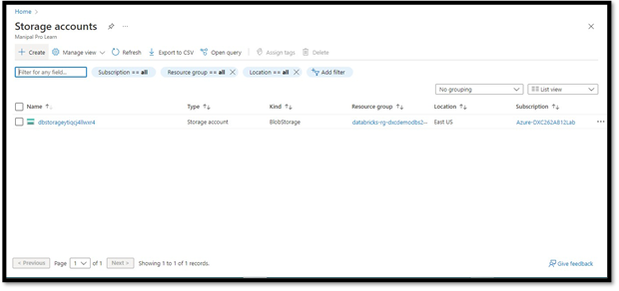
Step-4 Go to azure , search for storage. click on storage account. Click on +create

Slide 7
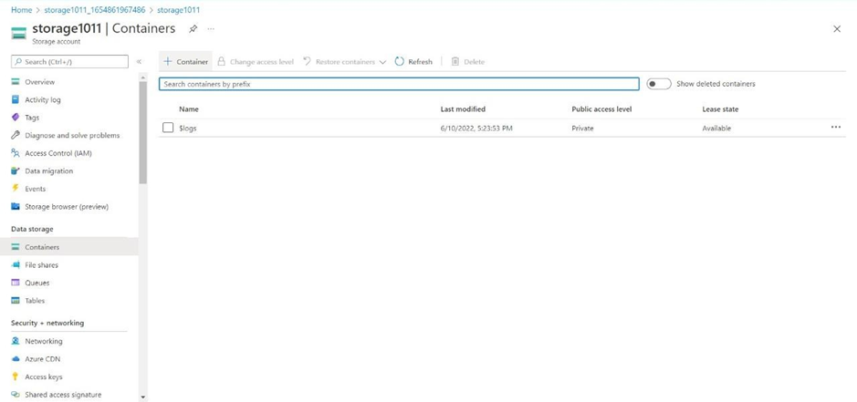
Step-5 : Fill up all the details and click on review+create. and, deploy it. Step-6 Once deployment is done click on resource group. Step-7 Navigate towards containers. click on + container to create a container.

Slide 8
Step-8 Container is used to store the data. click create. Step-9 Give a name to the container click on upload. Step-10 Since, we don’t have the source of the data we will make this container as the source of our blob data and will fill in a sample file to paste into the sql database. Step-11 Now we need a sql database to send the data to. go to sql databases. Open it. Fill the necessary details and deploy it.

Slide 9
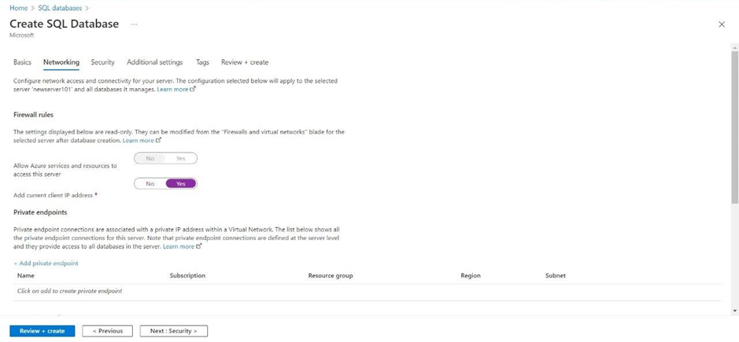
Step-12 Make sure to enable the firewall for the current ip and for the same azure cloud otherwise connecting sql database through data factory is not possible.

Slide 10
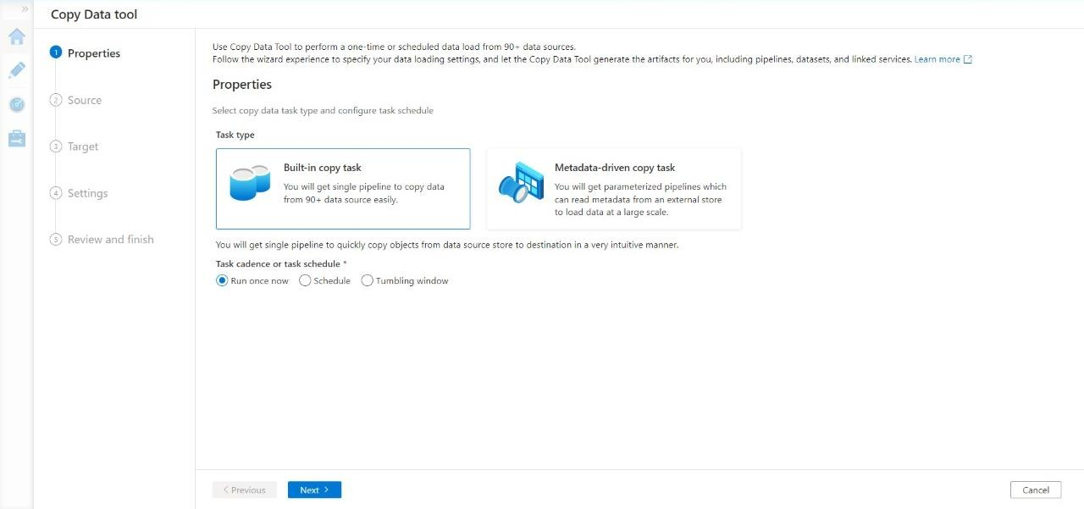
Step-13 Go ahead to deploy the database Step-14 After these steps come back to azure data factory lab. here we need to create a pipeline that will take data from blob storage and feed into the sql database. Click on ingest.

Slide 11
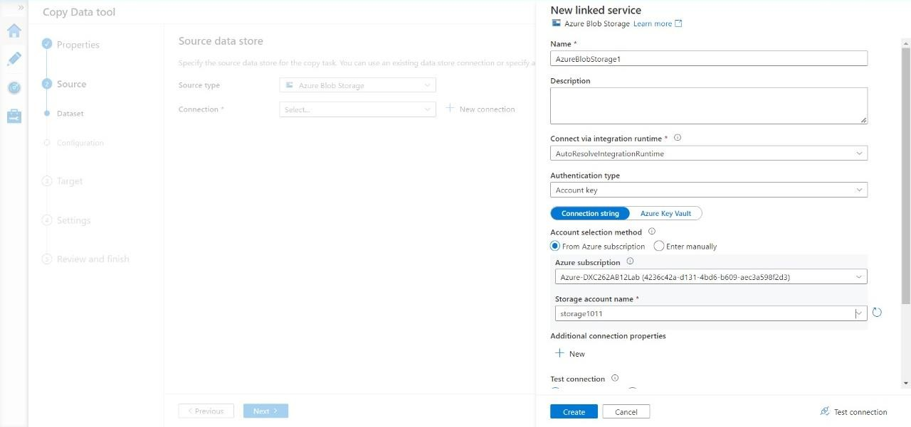
Step-15 Enter the name of azure blob storage linked file. select the name of storage account name we created in this and click on create.

Slide 12
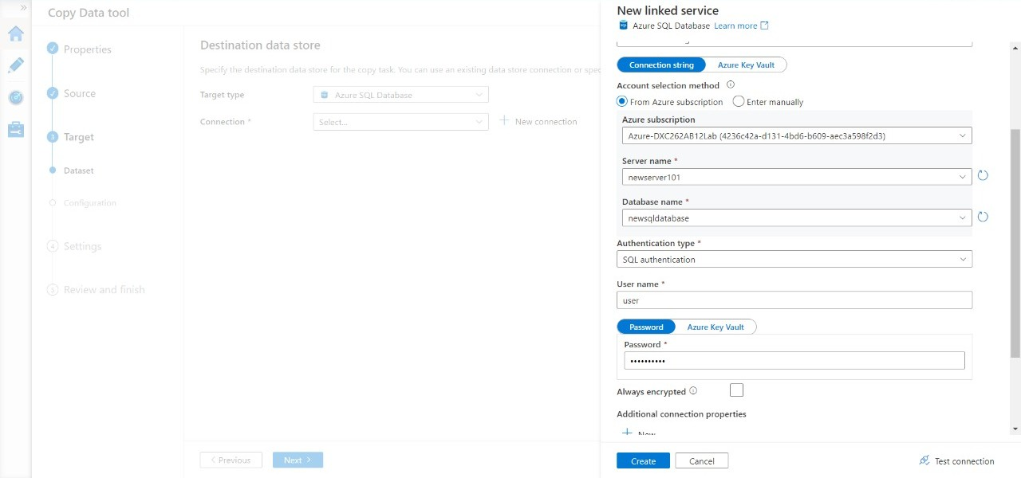
Step-16 Select the source type as blob storage and connection name that we created in previous step. click recursively from options. click next. Step-17 Now, in the next step we will link the data factory with sql database. connect the database with new connection.

Slide 13
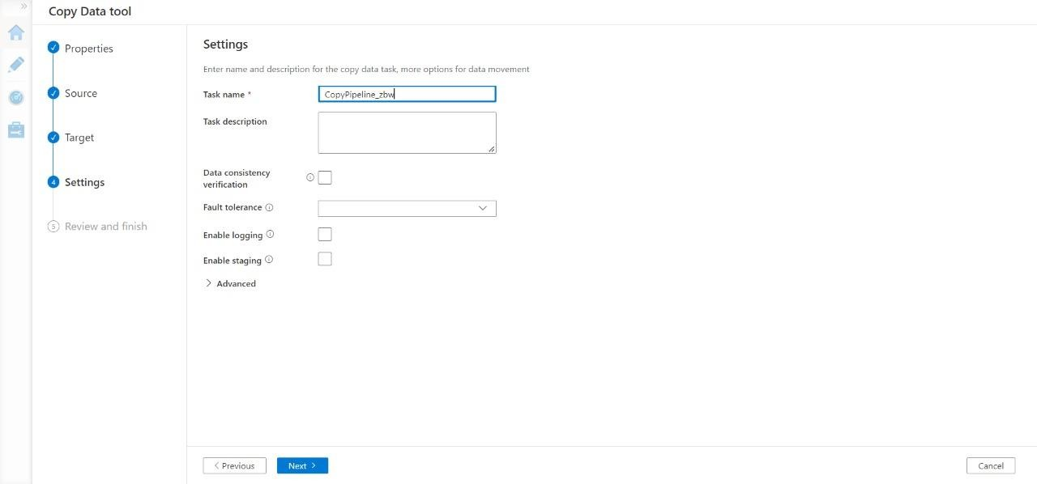
Step-18 Choose the file name you want to see in the sql database. click next .Now we are the end stage of creating pipeline, click next.

Slide 14
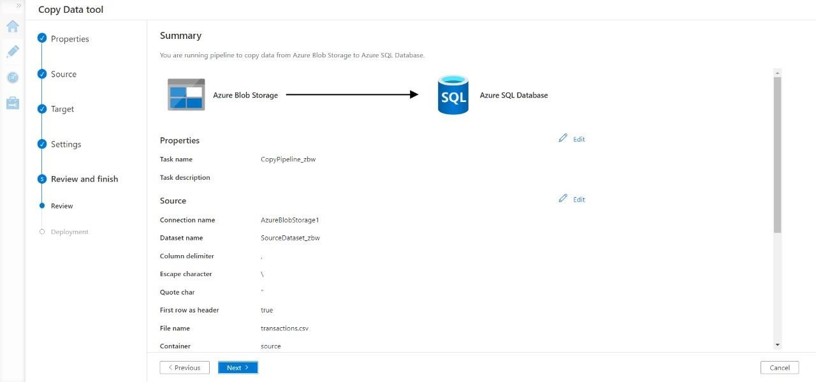
Step-19 Validate the data, connection , details and move forwards with next.

Slide 15
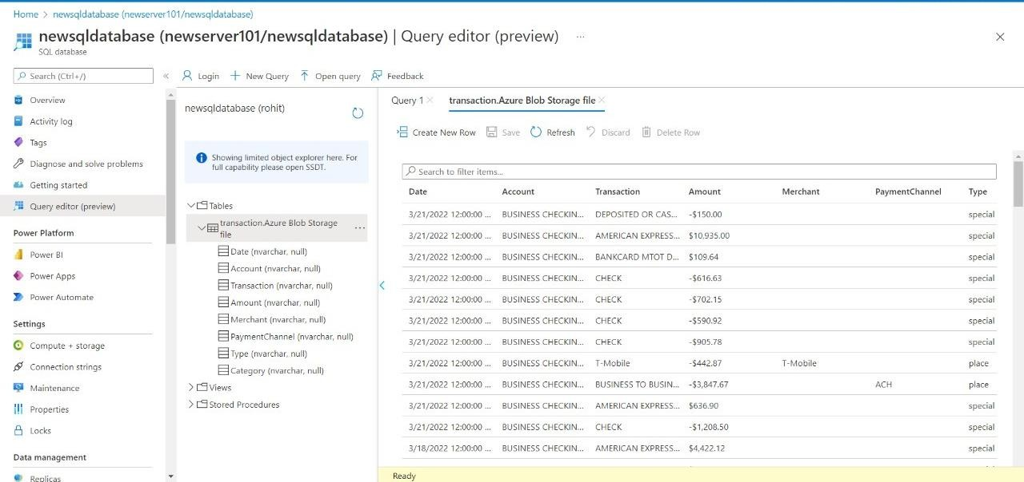
Step-20 Trigger the pipeline manually and navigate towards monitor , here we can see our pipeline has successfully ran once navigate towards sql database to check the data.

Slide 16
Result: In this project we were successful in creating a pipeline that will validate and copy the blob data into the sql database using azure data factory Conclusion: The blob data is being successfully validated and stored into sql database.

Slide 17
Project-2
AP Morgan Data Platform

Slide 18
1.Create a databricks 2.Create cluster in azure databricks 3.Add notebook in databricks and implement the business logic 4.Azure data factory for ap morgan 5.Create azure databricks linked service in adf

Slide 19
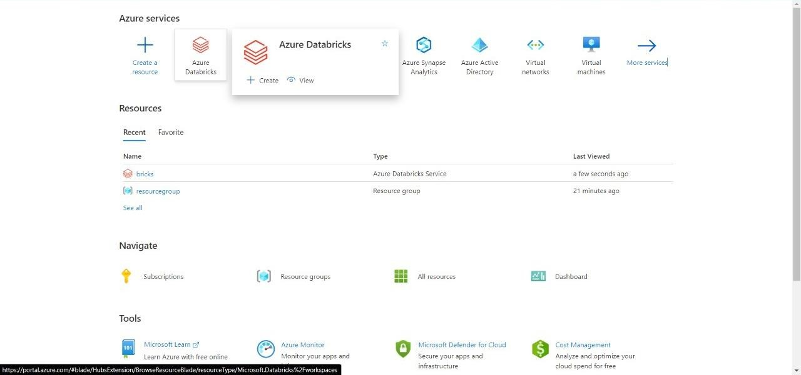
Step-1
Open Microsoft azure and create account for Data Factory and Azure Data Bricks
Search and open Azure Data Bricks.

Slide 20
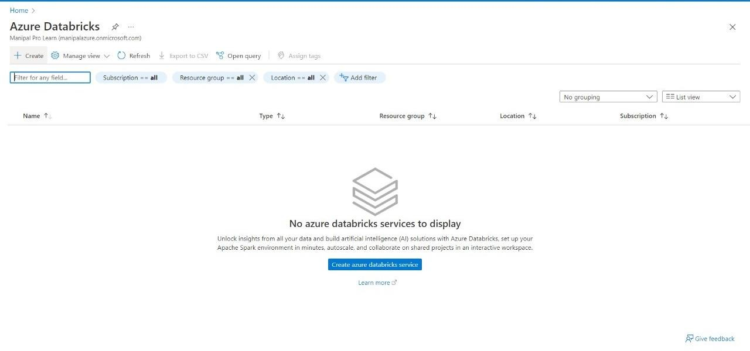
Step-2
Now create a new account into the Data Bricks.

Slide 21
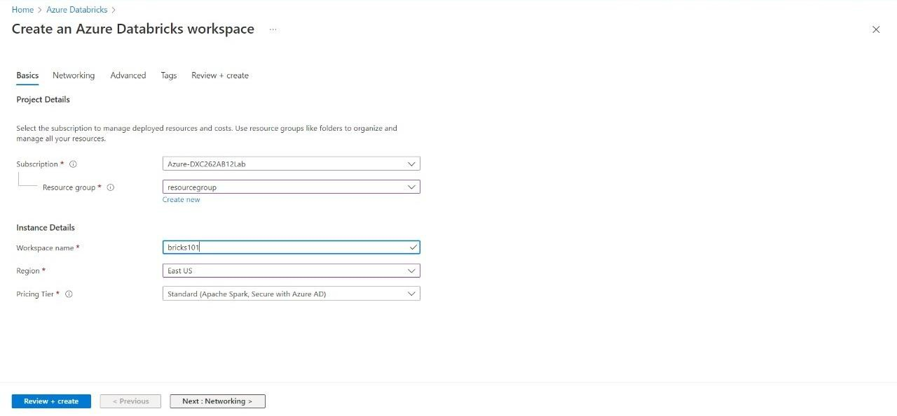
Step-3
Enter the account details.

Slide 22
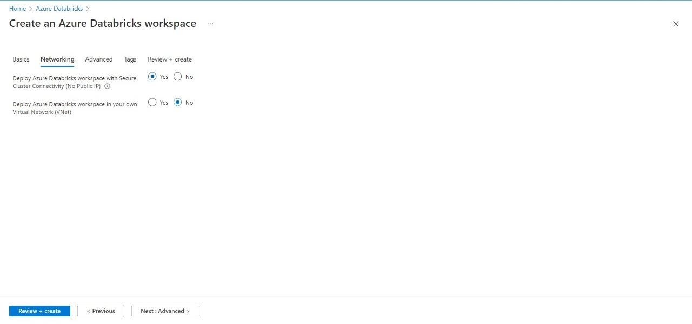
Step-4
Make sure to give permission for Cluster connectivity.

Slide 23
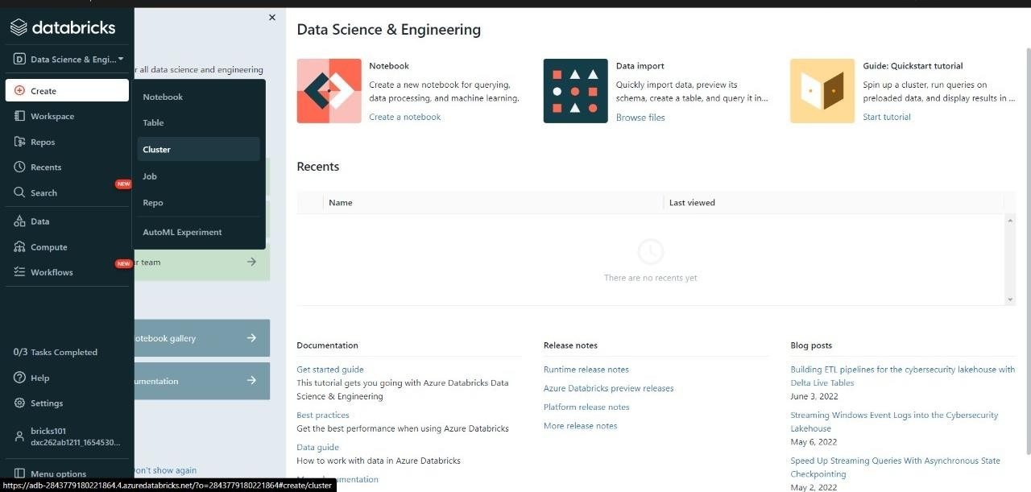
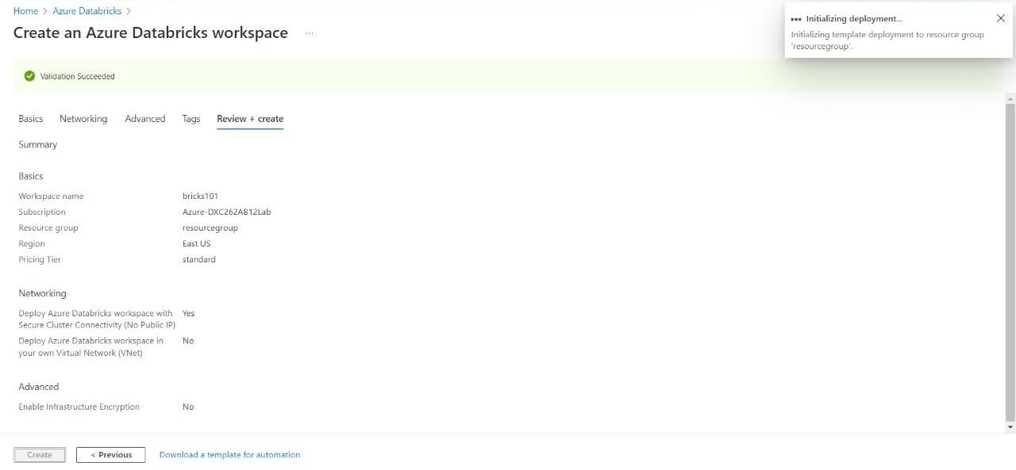
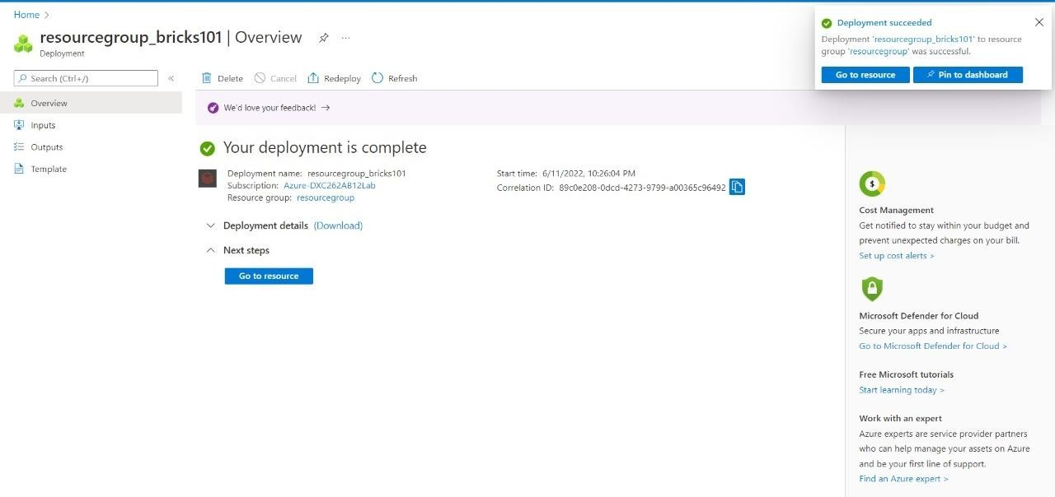
Step-6
Step-5
Step-7
After the deployment is done Navigate towards “Go to Resource”.
Launch the Workspace
Validate and create a DataBricks account

Slide 24
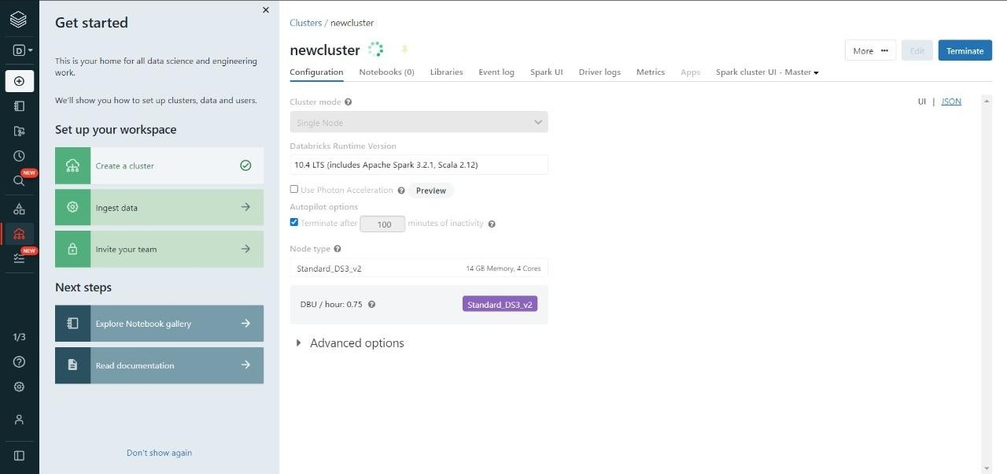
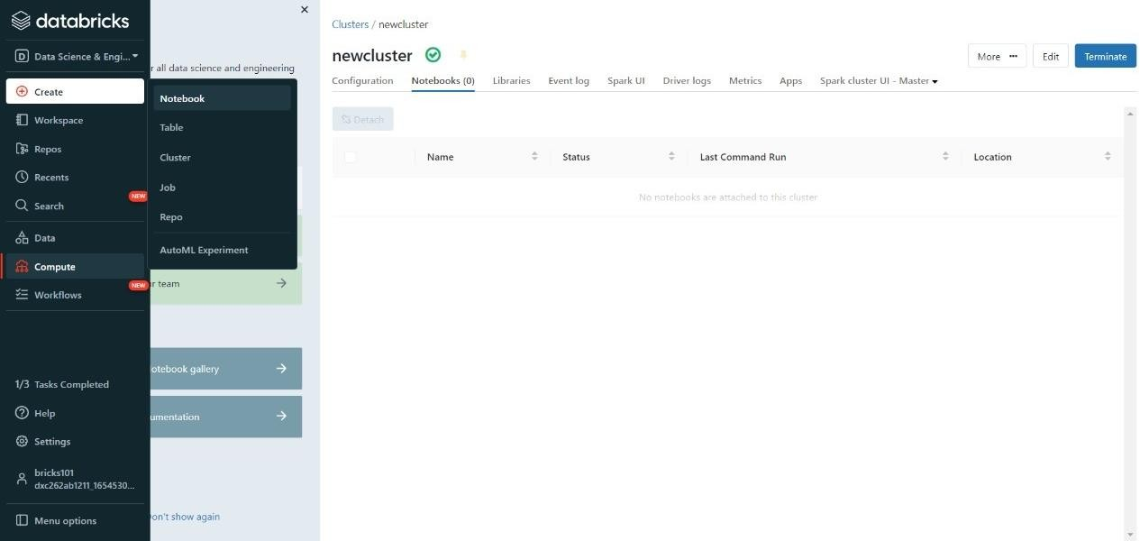
Step-9
Step-10
Step-8
After creating a new cluster, we need a notebook that will do some computation with the data present or incoming in databricks.
Create a new cluster to work upon.
Give the necessary credentials for the cluster and click on create.

Slide 25
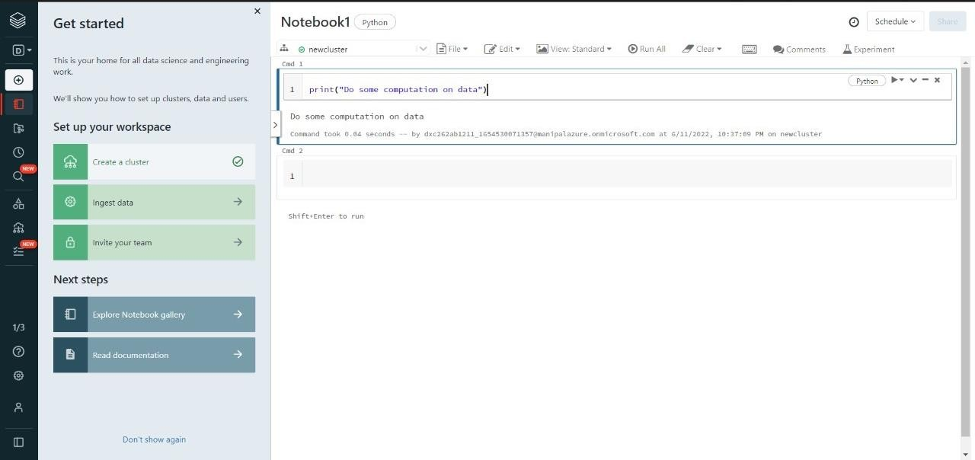
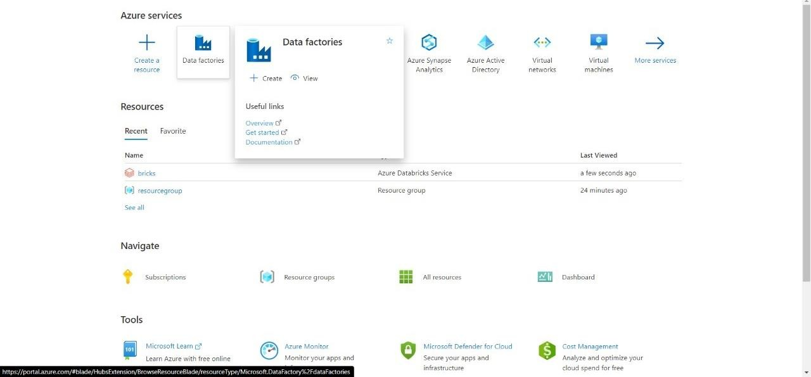
Step-12
Step-11
Now our notebook is ready to be linked and executed in Azure Data Factory
Go to azure home page and search for Data Factory
Give some operation or do the logic building in the notebook.

Slide 26
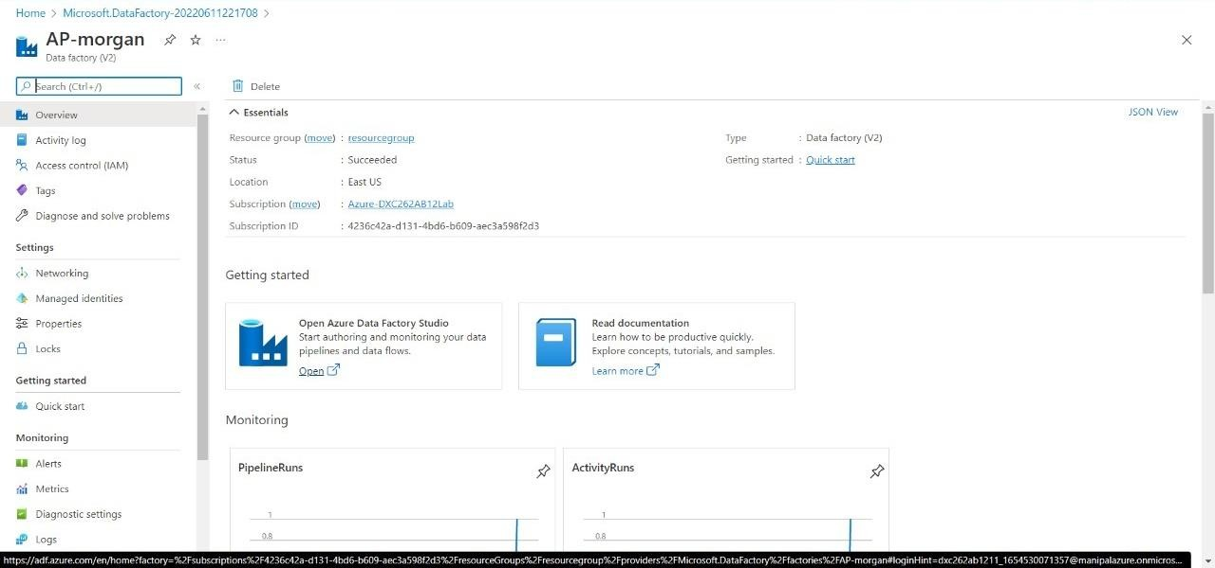
Create a new account on Azure Data Factory.
Enter the details for the Azure Data Factory account.
Validate and deploy the Data Factory.
After the deployment is done, navigate to “Go to resource”.
Step-13
Now open the Data Factory studio.

Slide 27
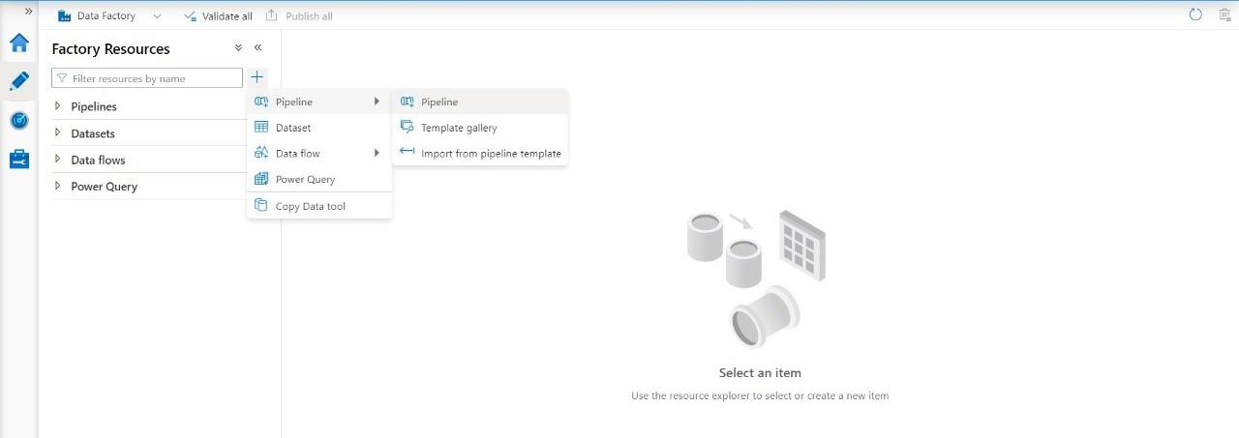
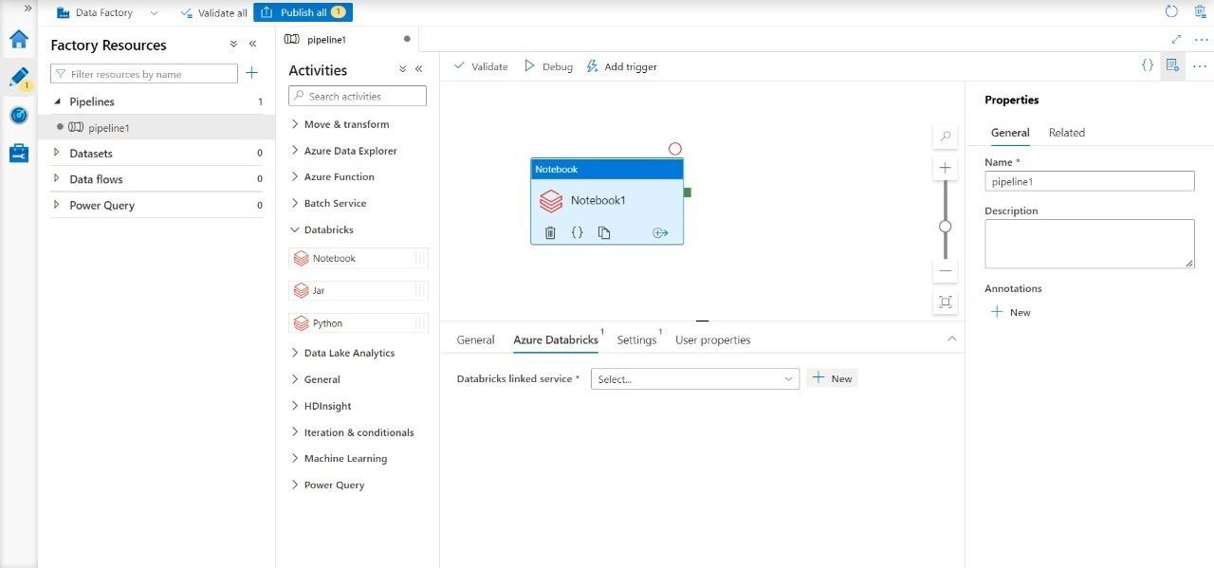
Step-14
Step-15
Create a new Pipeline and drag and drop the notebook tab from Azure Databricks dropdown into the pipeline workspace.
Step-16
We need to create a pipeline that will connect Data Bricks notebook with Data Factory.
Create a new Linked service for databricks
We need the access token of Data bricks account in order to access it.
Navigate to Data bricks workspace and go to Users in settings

Slide 28
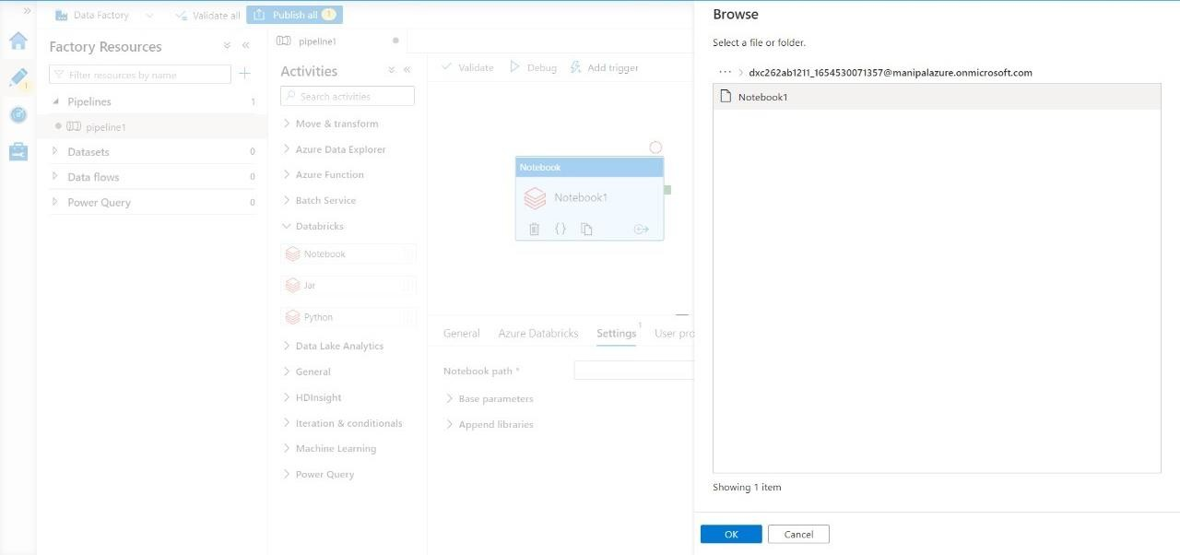
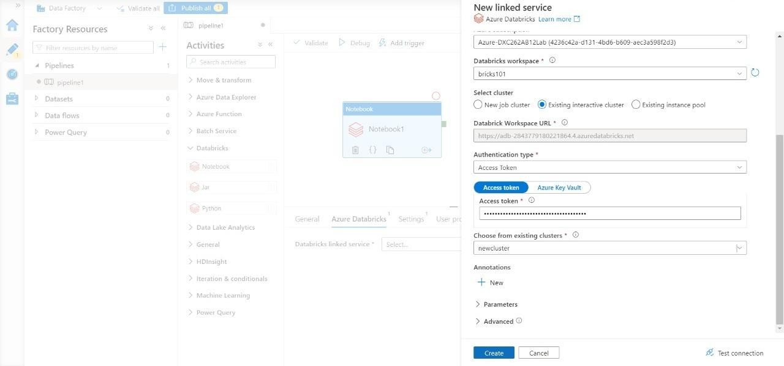
Step-17
Step-18
Click on “Generate token” and mention a small quick description name for the token.
After that a tab will open containing your access token, copy it and paste it in the azure factory data connection form.
Choose the right cluster and click on create.

Slide 29
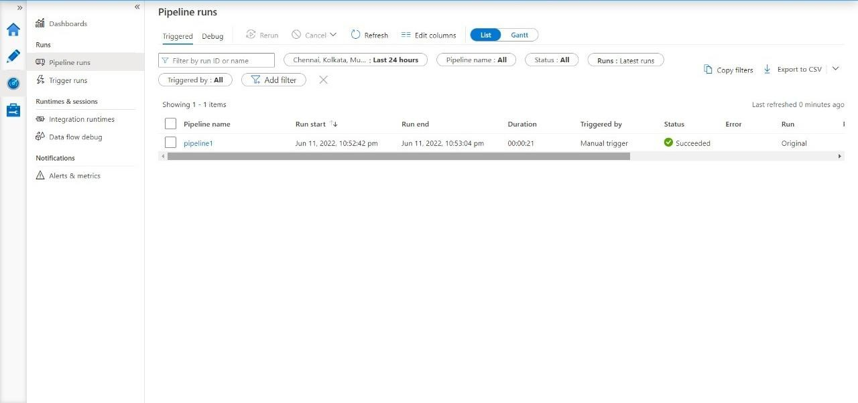
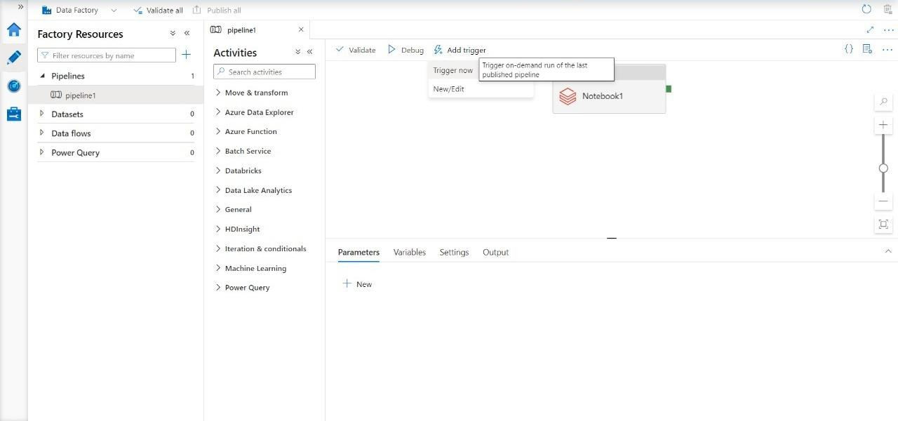
Step-19
Step-20
Go to Monitor window to check its execution.
Now choose the notebook in the pipeline notebook tab setting to trigger it.
Publish the pipeline to trigger it, after the publication is done, click on “Trigger now”.

Slide 30
We have successfully triggered a linked notebook of Data bricks from Data Factory.
Result:
Successfully able to link and trigger Azure DataBricks notebook using Data Factory.
Conclusion:
Azure Data Factory linked with Azure Data bricks

Slide 31


